Slide 1
Warm-up
A Major League Baseball team is allowed to have 25 players. The ratio of pitchers to position players on one team is 2:3. How many position players are on the team?
A camera store developed 2100 rolls of film in one month. Customers wanted double prints from 1500 of these rolls. What is the ratio of rolls with double prints to rolls developed?

Slide 2
Fraction
To
Decimal
Decimal
To
Fraction
Fraction
To
Percent
Percent
To
Fraction
Decimal
To
Percent
Percent
To
Decimal

Slide 3
Shutter Fold Foldable™
Materials Needed
1 sheet 8.5 X 11 paper
marker

Slide 4
Shutter Fold Foldable™
Fold one 8.5 X 11 sheet of paper like a ‘hamburger’.
Crease, then open.
↑
Crease

Slide 5
Shutter Fold Foldable™
Fold the outer edges of the paper to meet at the center.

Slide 6
Shutter Fold Foldable™
Fold into thirds.

Slide 7
Shutter Fold Foldable™
Label each section as shown.
Fraction To Decimal
Decimal To Fraction
Fraction To Percent
Percent To Fraction
Decimal To Percent
Percent To Decimal

Slide 8
Decimal
To
Fraction
Open this side first!
Percent
To
Fraction
Percent
To
Decimal

Slide 9
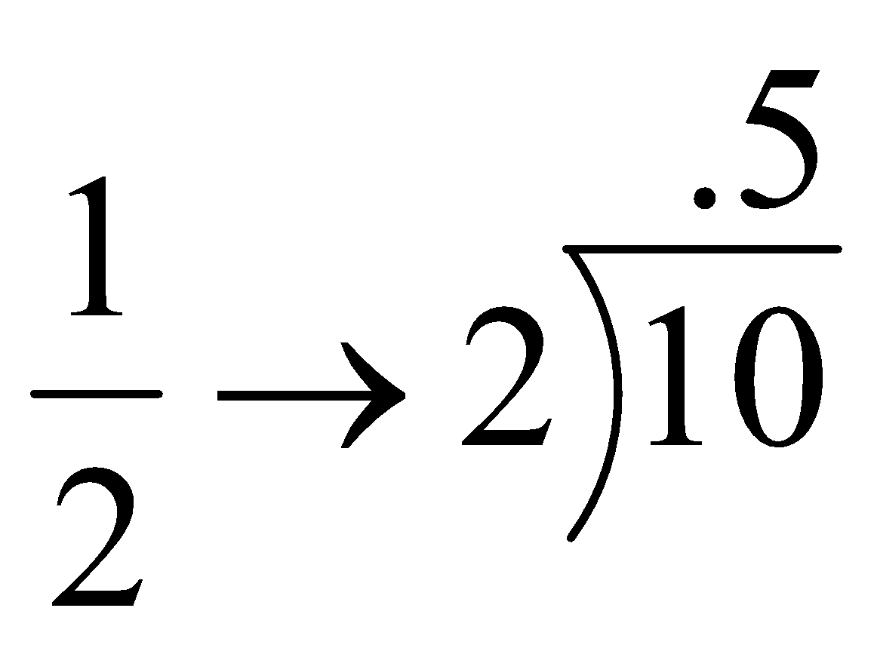
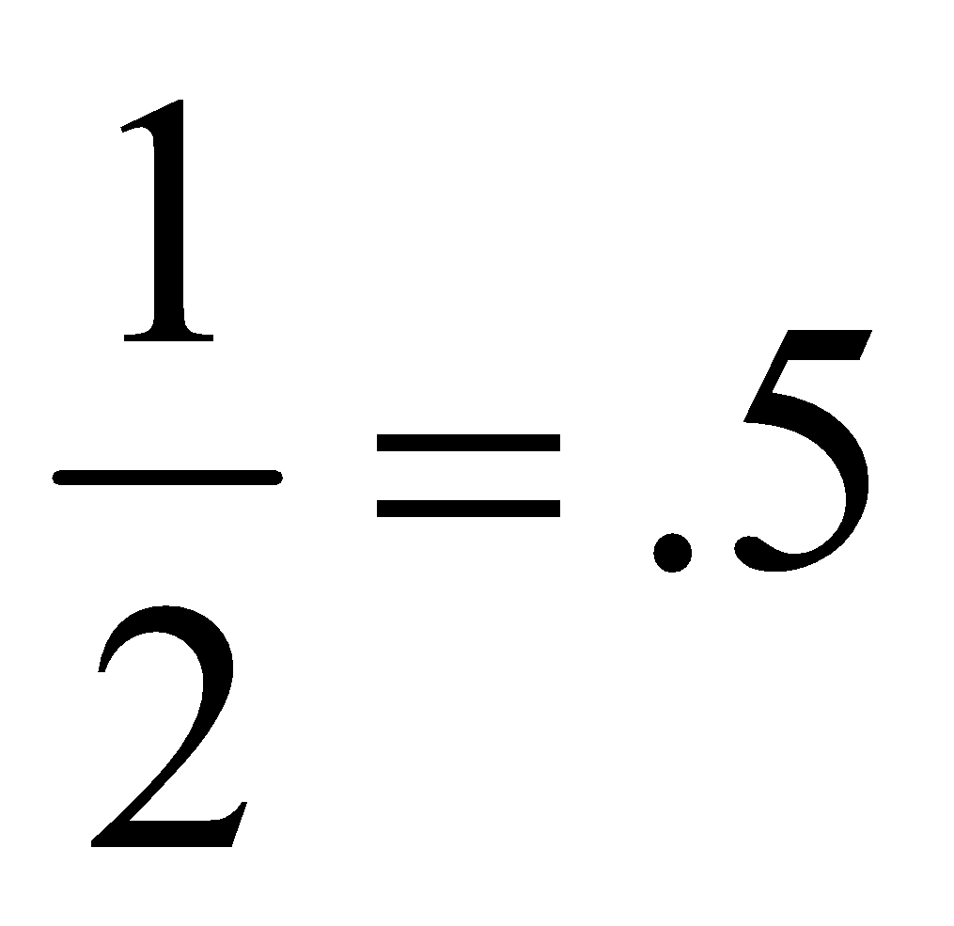
Fraction
To
Decimal
Top Dog
in the house!

Slide 10
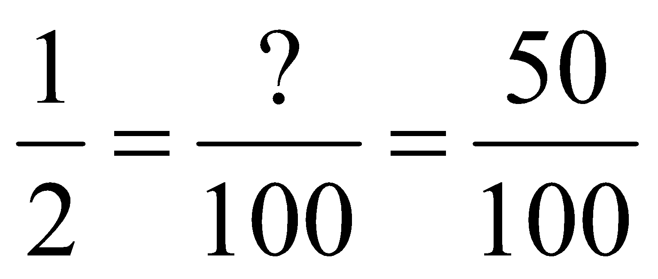
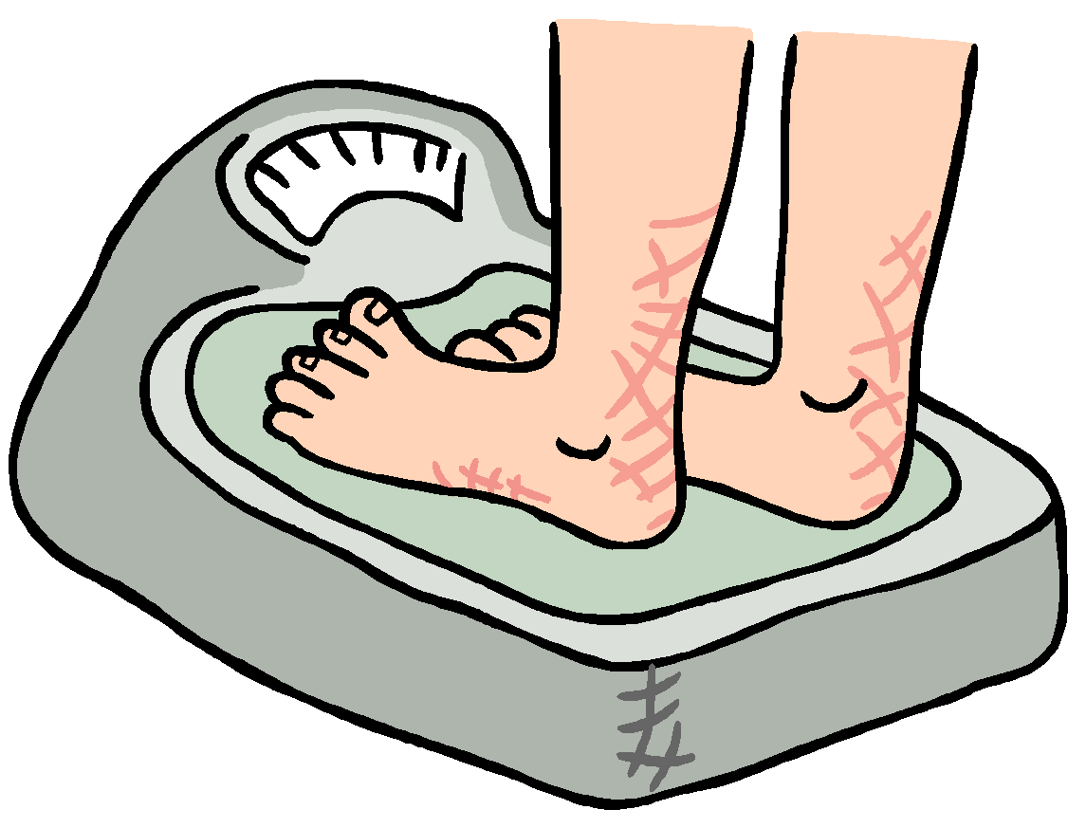
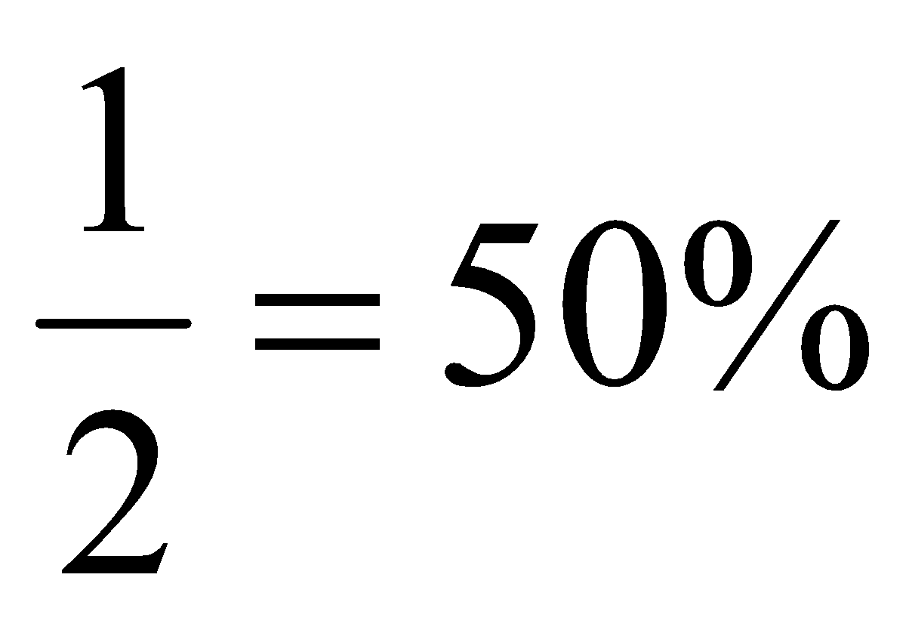
Fraction
To
Percent
x 50
Scale
per
cent
x 50
factor

Slide 11
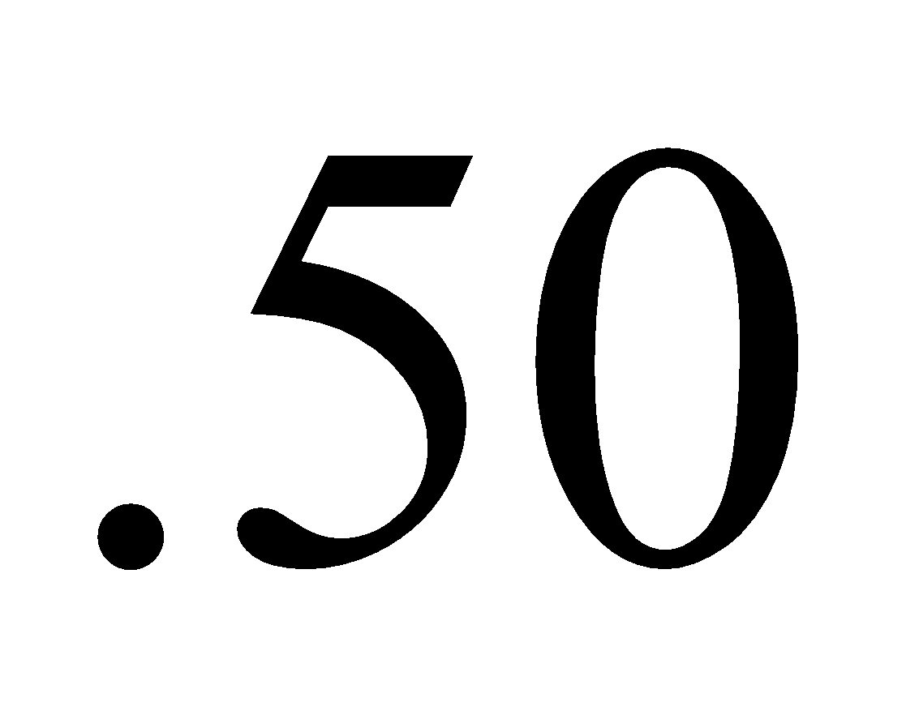
Decimal
To
Percent
Decimal
2 places to the right
50%
.50 = 50%
Percent

Slide 12
Fraction
To
Decimal
Open this side next!
Fraction
To
Percent
Decimal
To
Percent

Slide 13
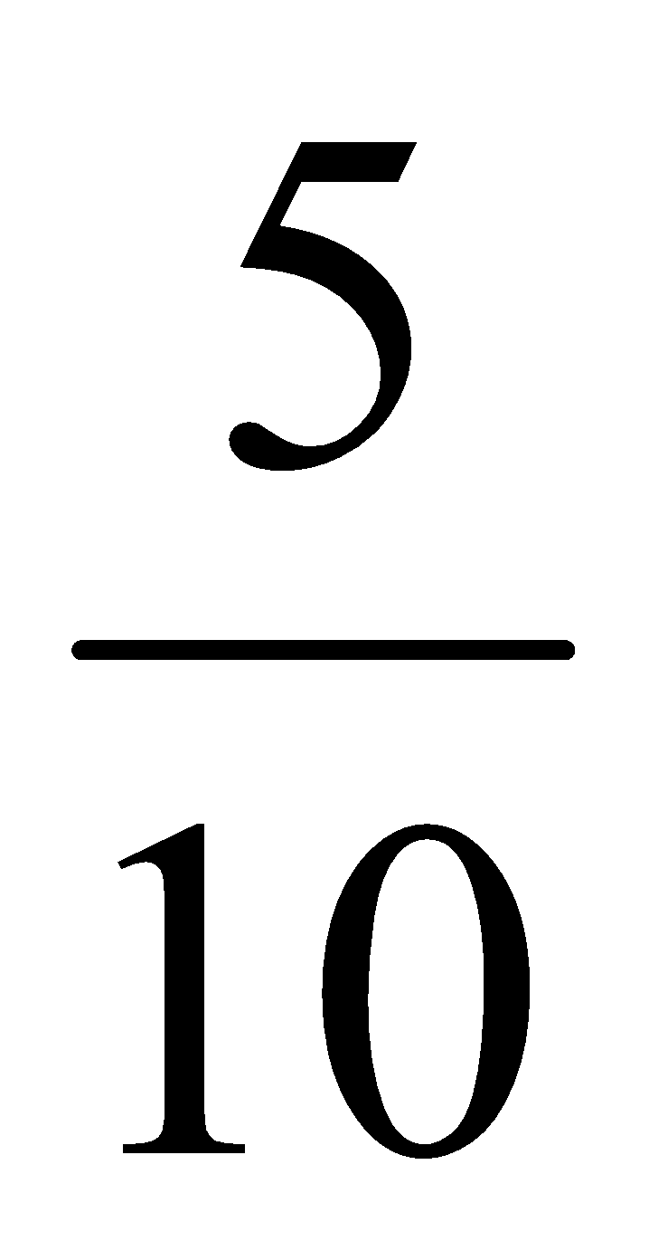
Decimal
To
Fraction
Reduce!
Tenths place
.5 =
place value

Slide 14
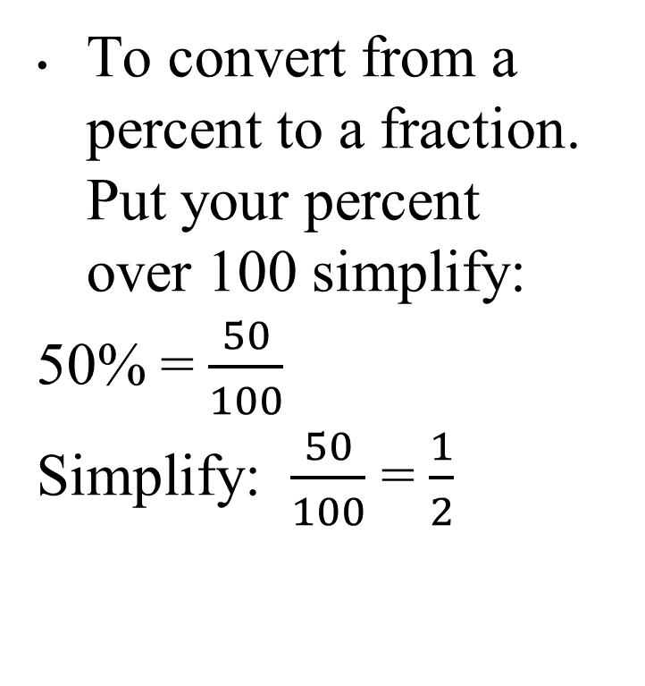
Percent
To
Fraction
To convert from a percent to a fraction. Put your percent over 100 simplify:
50% = $\frac{50}{100}$
Simplify: $\frac{50}{100}$ = $\frac{1}{2}$
Scale
factor

Slide 15
Percent to Decimal
Move the decimal 2 places to the left and add a percent sign.
50%
0.50
Decimal

Slide 16
FRACTIONS
DECIMALS
PERCENTS

Slide 17
Essential Question
How do I express fractions as decimals ?
* Use long division
* Numerator goes inside
* Denominator goes outside

Slide 18
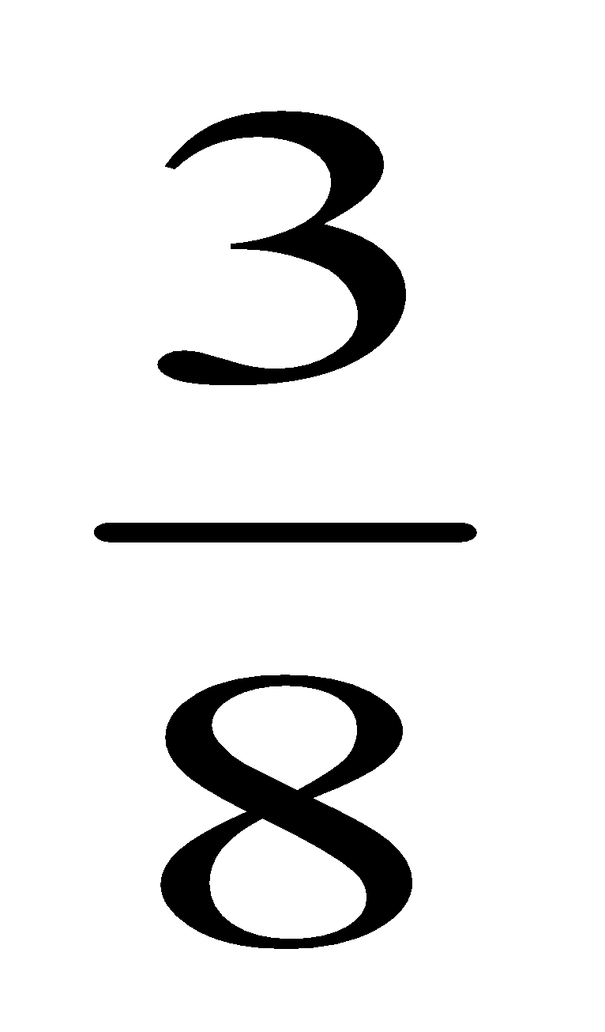
Example 1:
Express
as a decimal.
0
3
7
5
.
Begin long division
8
3
.00
0
Add decimal and zeros as needed
-24
Align decimal and divide
6
0
-56
4
0
Answer will:
-40
* Terminate
0
OR
* Repeat

Slide 19
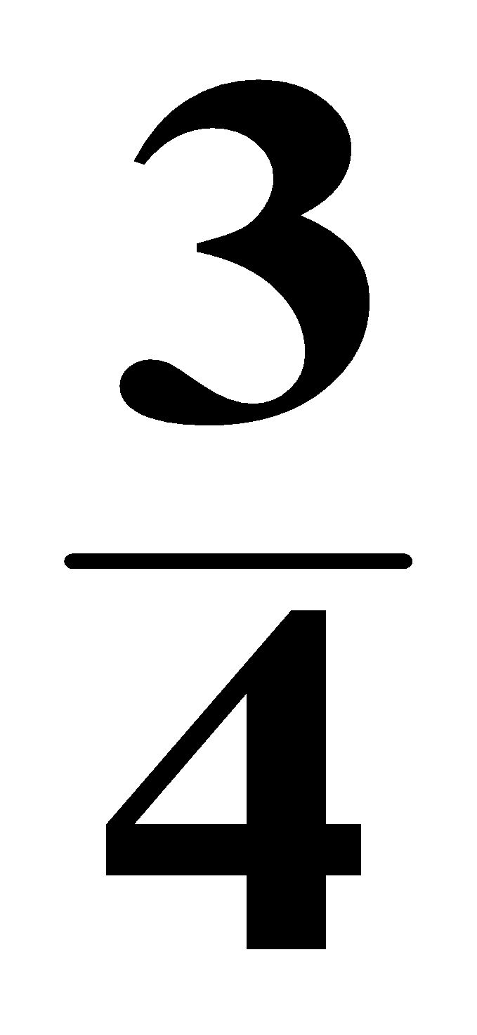
Express
as a decimal.
You try:
0
7
5
.
4
3
.00
-28
2
0
-20
0

Slide 20
Essential Question
How do I express mixed numbers as decimals ?
* Set up long division on the fraction part
* Place whole number in front of decimal

Slide 21
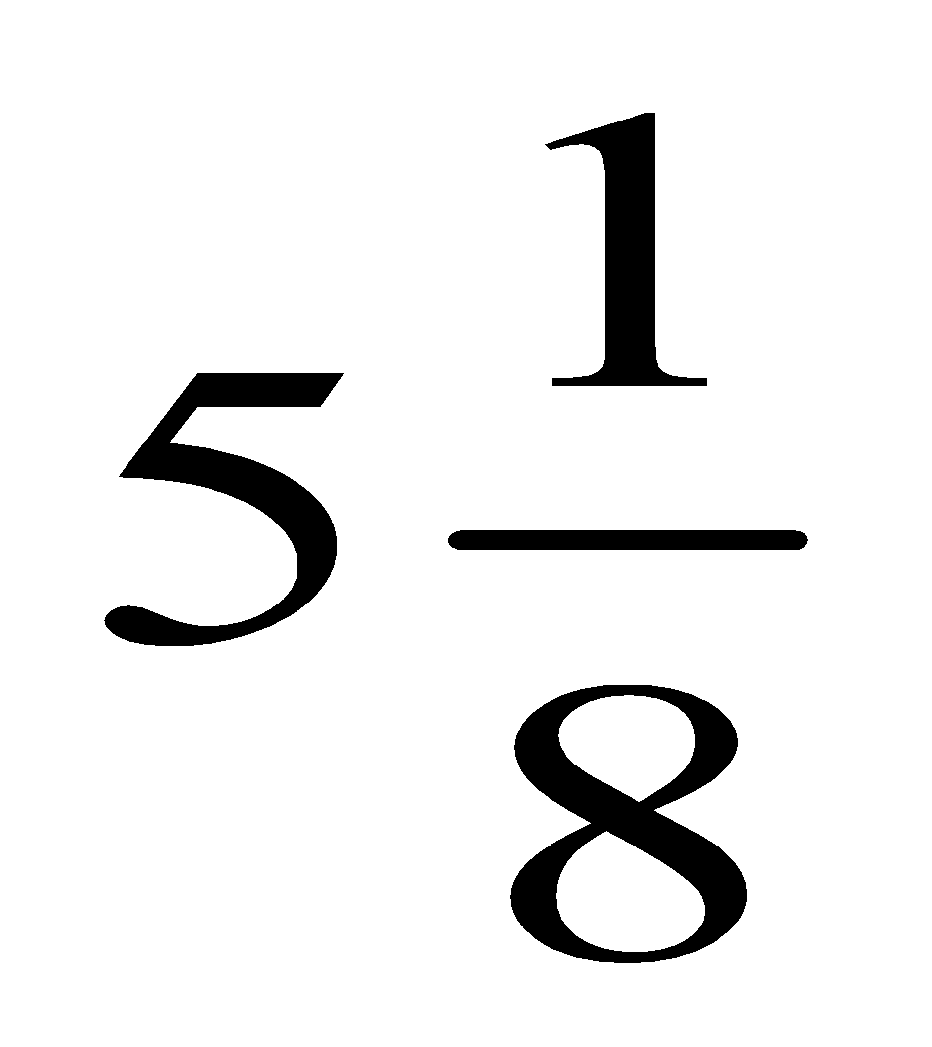
Example:
Convert
to a decimal.
5
1
2
5
* Set up long division on the fraction part and complete the division.
.
8
1
.00
0
- 8
2
0
* Place whole number in front of decimal
-16
4
0
-40
* This is the final answer
0
.

Slide 22
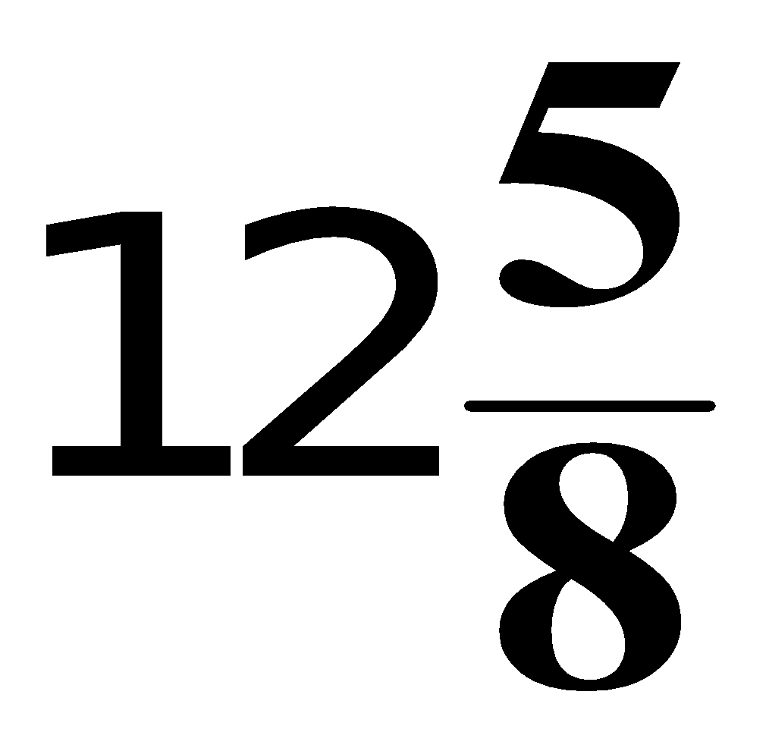
Convert
to a decimal.
You try:
12
6
2
5
.
8
5
.00
0
-48
2
0
-16
4
0
-40
0
.

Slide 23
Essential Question
How do I express decimals as fractions?
* Convert decimal to base 10 fraction
* Simplify

Slide 24
Examples:
Convert decimal to base 10 fraction; simplify
4
2
0.4
=
=
10
5
35
7
0.35
=
=
100
20
28
14
7
7.28
7
7
7
=
=
=
100
50
25

Slide 25
You try
Convert decimal to base 10 fraction; simplify
8
4
0.8
=
=
10
5
4
2
1
0.04
=
=
=
100
50
25
36
18
9
3.36
3
3
3
=
=
=
100
50
25

Slide 26
Essential Question
How do I express Decimals as Percents?
* Move decimal point 2 places to the right
* Add the % sign

Slide 27
Examples:
Express 0.375 as a percent
Move decimal point 2 places to the right and add the % sign.
0.375
37.5 %
=
Convert 2.867 to a percent
2.867
286.7 %
=

Slide 28
You Try
Convert decimals to percents
0.625
62.5 %
=
.7
0
70 %
=
Make sure there are at least two digits at the decimal points; add zero where needed (this does not change the value of the number).

Slide 29
Essential Question
How do I express Percents as decimals?
* Move decimal 2 places to the left
* remove the % sign

Slide 30
Example:
Express 56.25 % as a decimal
Move decimal point 2 places to the LEFT and remove the % sign.
56.25 %
.5625
=
125 %
1.25
=

Slide 31
You try
Express the percents as decimals
97 %
=
.97
0
3.5 %
.035
=
42.8 %
.428
=

Slide 32
Essential Question
How do I express fractions as percents?
* Set up a proportion : "out of 100"
or
* Change fraction to decimal, then change the decimal to percent

Slide 33
Example:
Express as a percent.
Set up an “ out of 100 ” proportion
Convert numerator
x 25
1
25
25 %
=
=
4
100
x 25
Check to see how you would convert the first denominator to 100.

Slide 34
You try
Express as a percent.
x 20
3
60
60 %
=
=
5
100
x 20

Slide 35
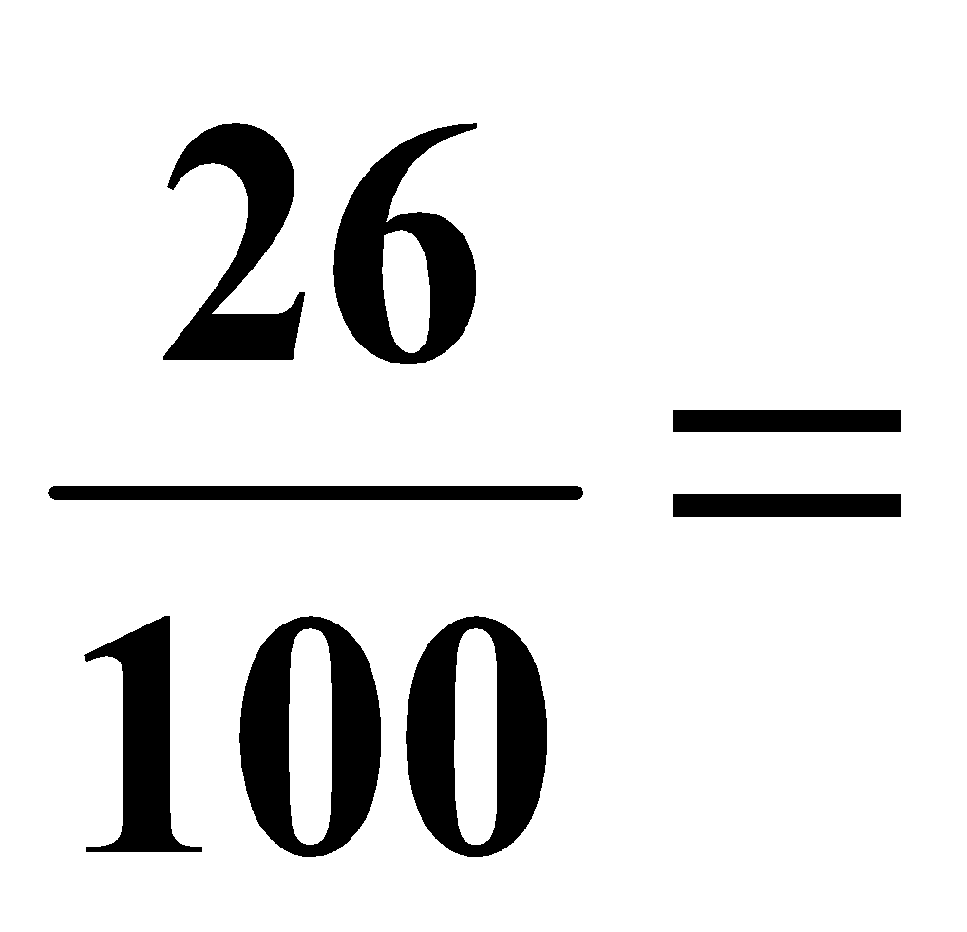
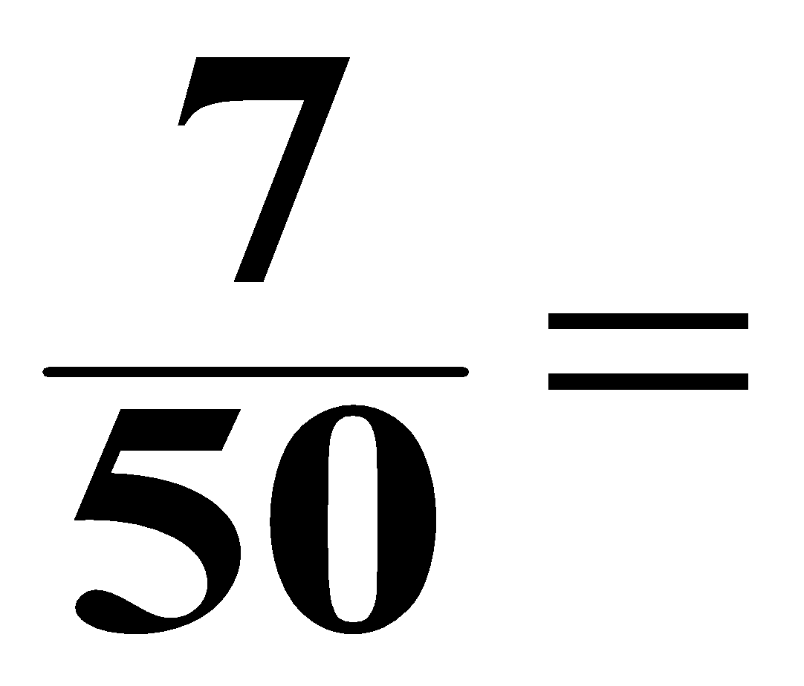
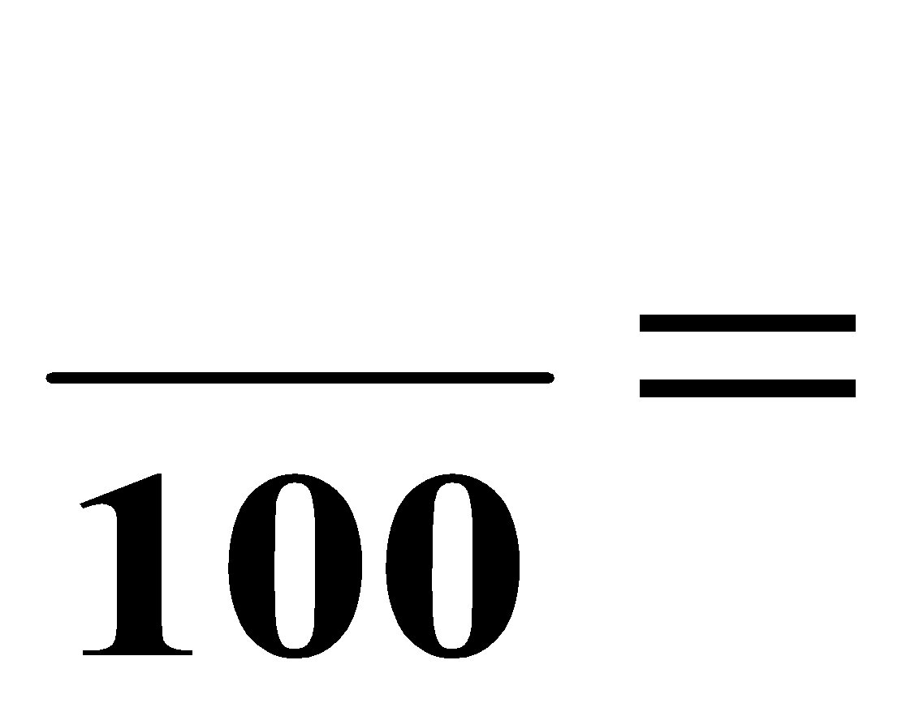
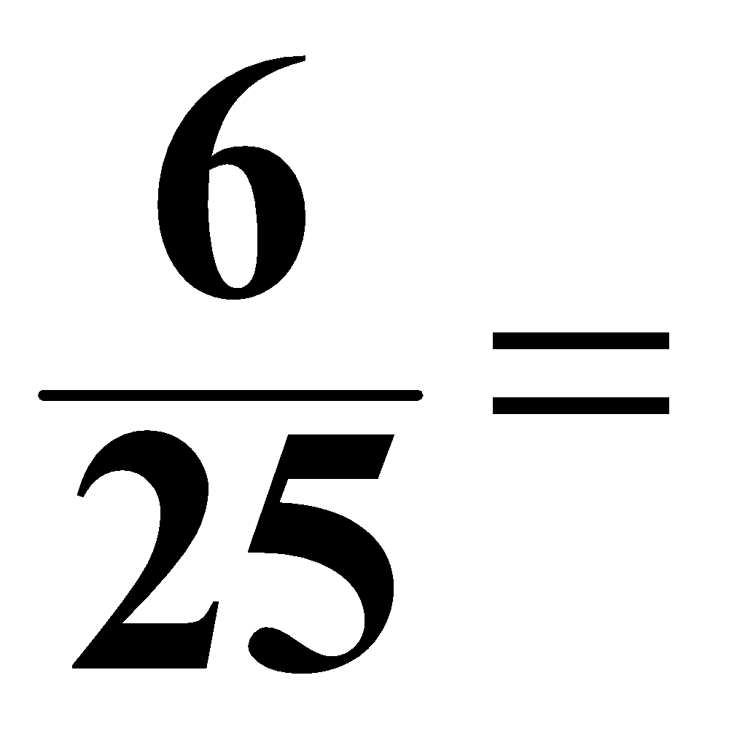
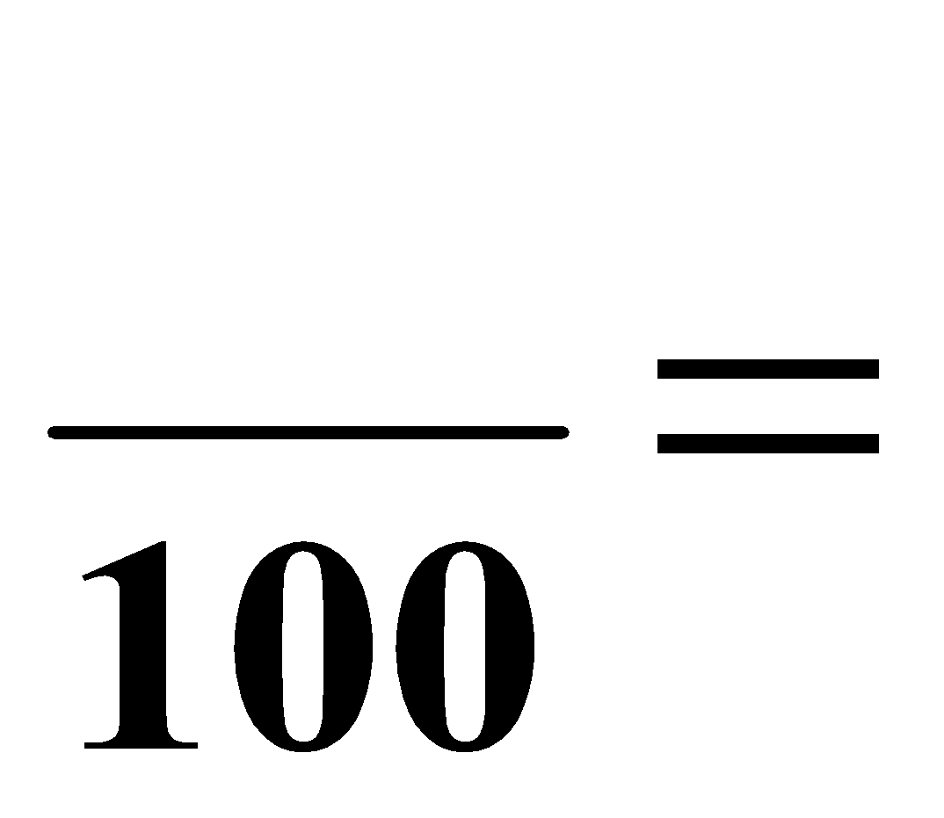
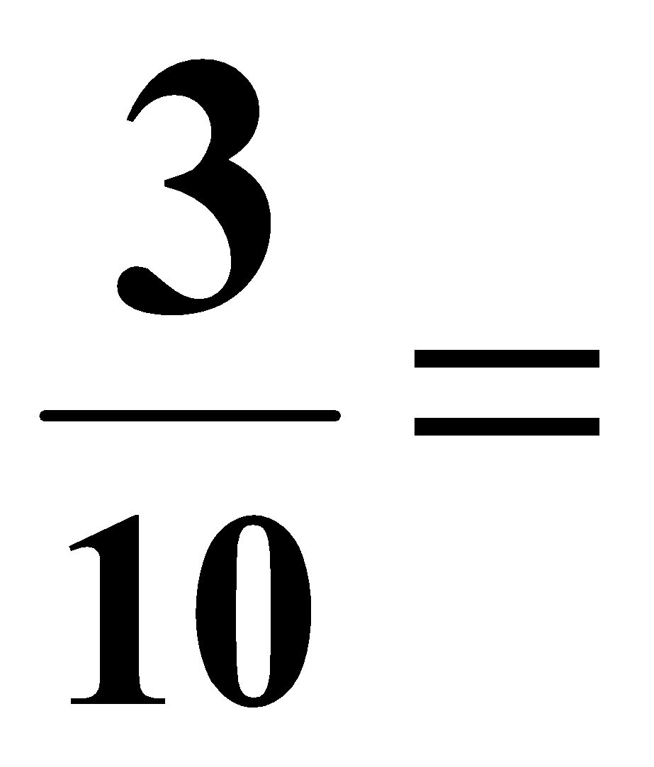
You try some more
Convert fractions to percents.
x 2
14
26 %
14 %
x 2
x 4
x 10
24
30
24 %
30 %
x 4
x 10

Slide 36
Or you can express fractions
as percents by long division
1
0.25
=
4
Convert decimal to percent by moving 2
decimal places to the right and adding % sign
0.25
25 %
25.0 %
=
or

Slide 37
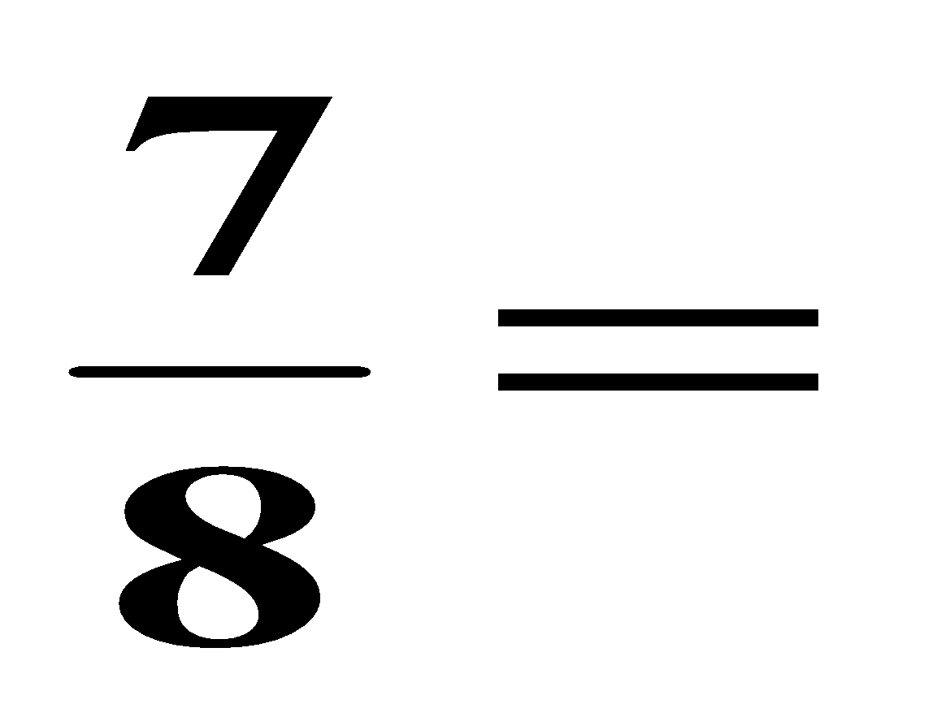
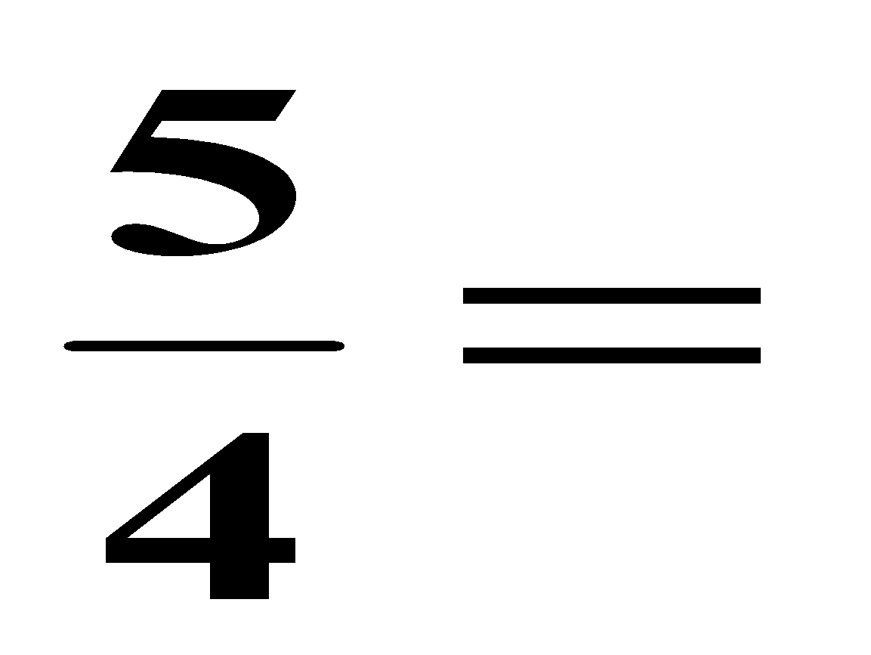
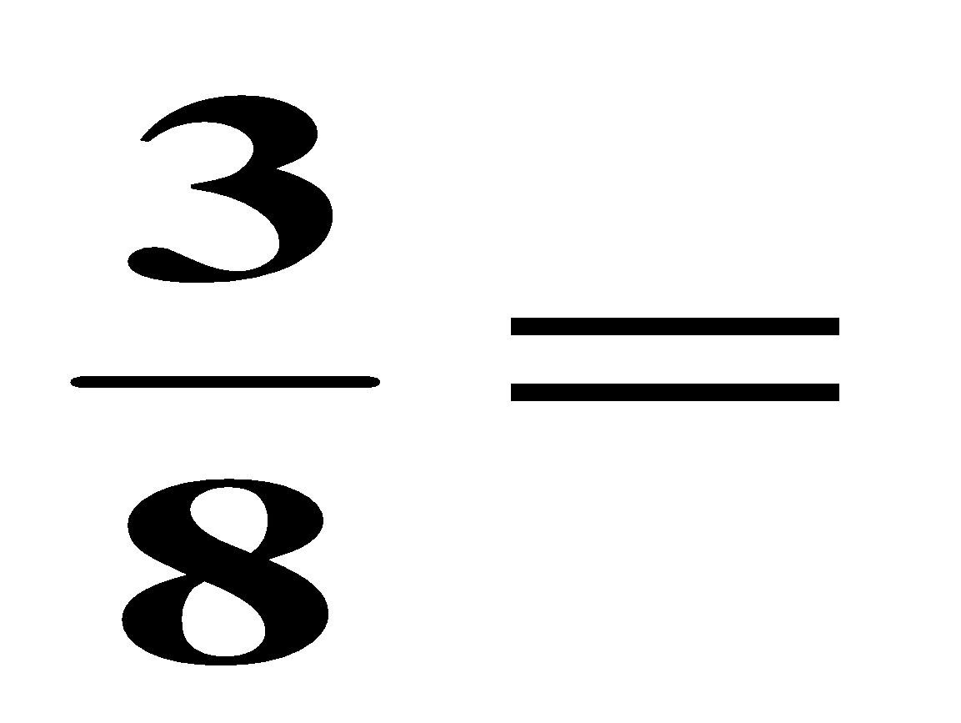
You try:
Express fractions as percents by long division
0.875
87.5 %
=
1.25
125 %
=
.375
37.5 %
=

Slide 38
Essential Question
How do I express percents as fractions?
* Divide the number by 100
* Remove the percent symbol
* Simplify

Slide 39
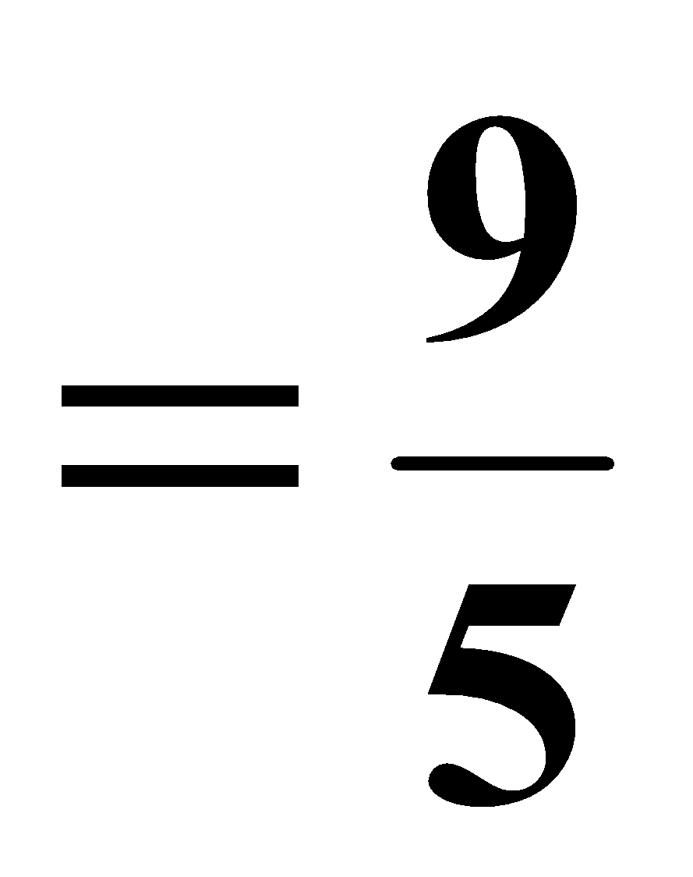
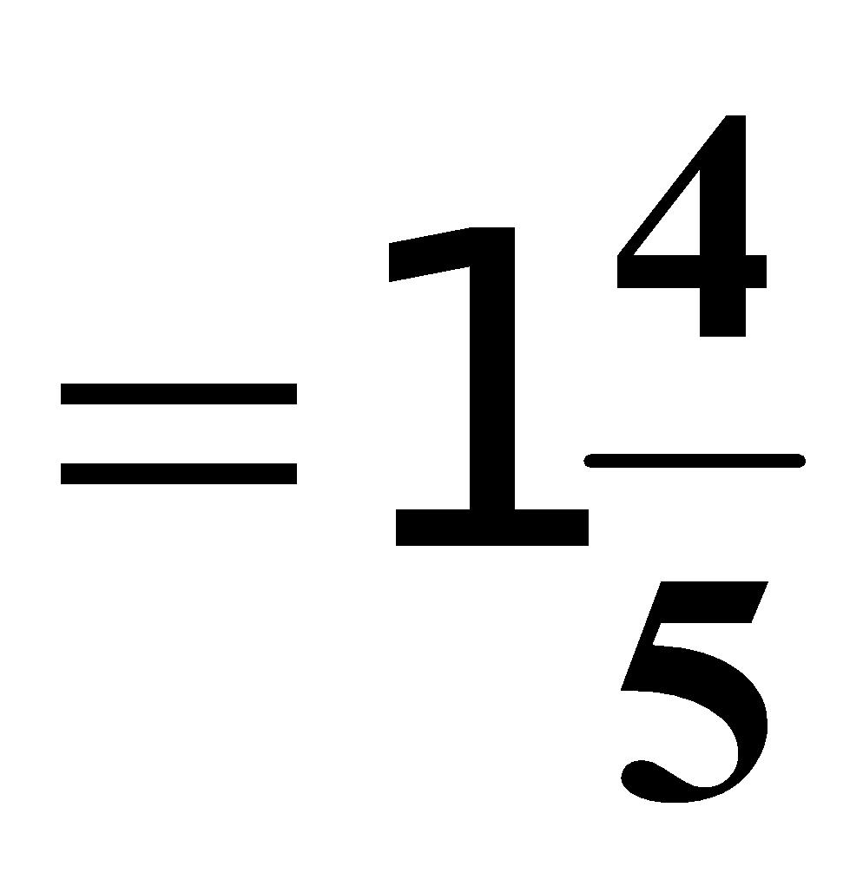
Examples:
Express percents to fractions by dividing by 100
30
3
30 %
=
=
100
10
6
3
6 %
=
=
100
50
180
18
180 %
=
=
100
10

Slide 40
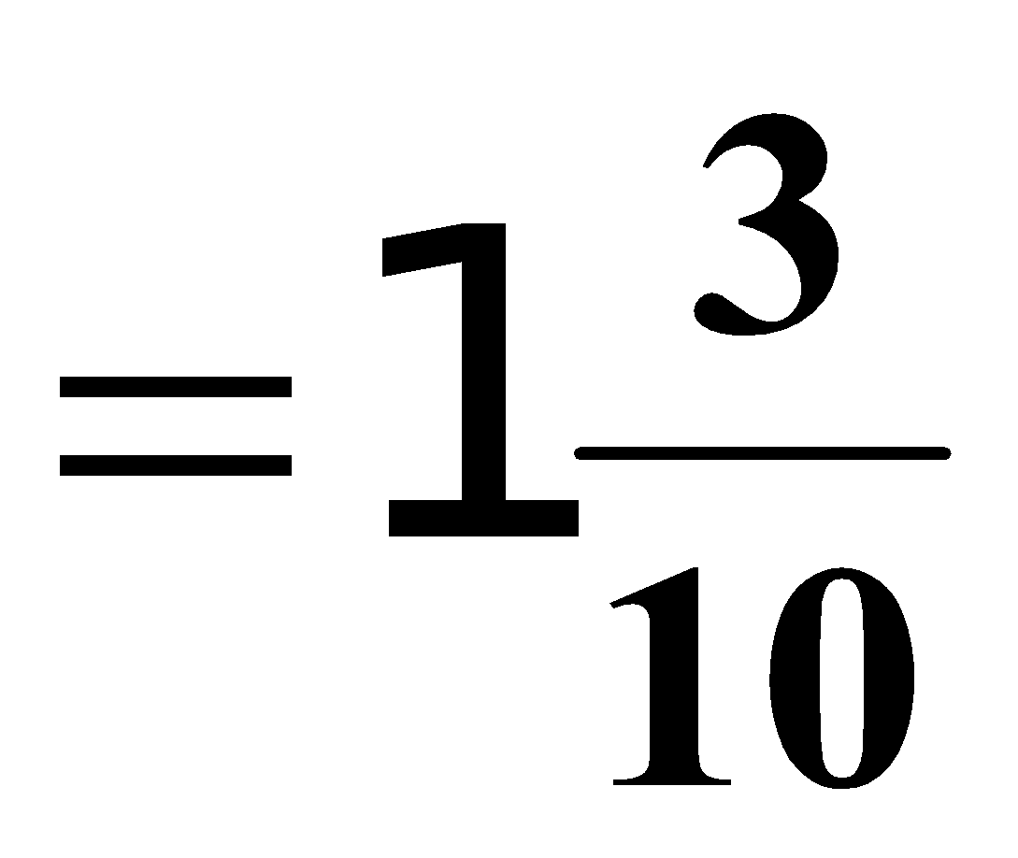
You try
Express percents to fractions by dividing by 100
35
7
35 %
=
=
100
20
5
1
5 %
=
=
100
20
130
13
130 %
=
=
100
10

